Slide 1
Predicting Chronic Kidney
Disease using Machine Learning
By: Abbas Shafi

Slide 2
About the Dataset
21,000
36
5
0%
Records
Features
Original CKD Stages
Missing Values
Feature Groups
Original Target Distribution
Demographics
Age, Gender, BMI
Healthy Kidney
16,000
75.0%
Blood Pressure
Systolic_BP, Diastolic_BP
Mild CKD (Stage 1-2)
2,396
12.0%
Renal Function
eGFR, Creatinine, BUN
Moderate CKD (Stage 3)
1,325
6.6%
Urine Analysis
Albumin, Protein, ACR, SG
Haematology
Hb, RBC, WBC, Platelets, PCV
Severe CKD (Stage 4)
817
4.1%
Metabolic
HbA1c, Glucose, Cholesterol
Kidney Failure (St. 5)
400
2.0%
Electrolytes
Na, K, Ca, P, Cl, HCO₃
Comorbidities
Diabetes, Hypertension, Smoking

Slide 3
Statistical Analysis & EDA
Descriptive Statistics — Key Features
Key EDA Findings
Feature
Mean
Std
Min
Max
Class Imbalance
Age (years)
52.04
18.79
20
84
75% Healthy vs 25% CKD , 3:1 ratio requires balancing
BMI
26.00
4.95
18
34
Zero Missing Values
Systolic BP
113.3
19.0
90
189
All 21,000 rows complete , no imputation needed
eGFR (mL/min)
91.9
26.7
5
119
Serum Creatinine
0.62
1.45
0
9
Synthetic Boundaries
Multiple features had hard non-overlapping class ranges
HbA1c (%)
6.98
1.71
4
10
Hemoglobin
13.45
2.30
5
16
BUN
21.63
20.66
7
149
Note on Synthetic Data: Many features show perfectly non-overlapping ranges between classes (e.g., eGFR: Healthy=90–119, CKD=5–89 with zero overlap). This is characteristic of programmatically generated data — feature values were assigned based on the target label, not independently measured.

Slide 4
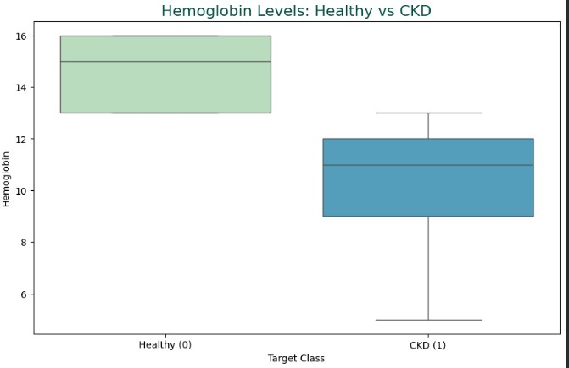
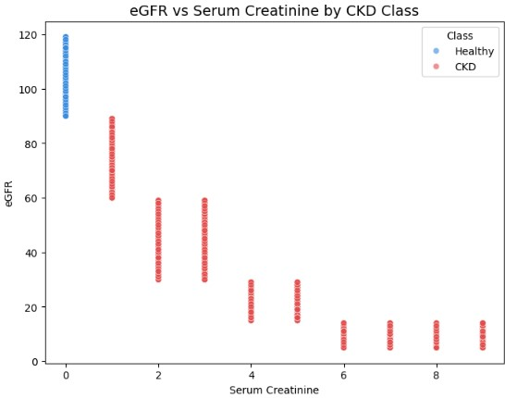
EDA Visualizations
Whisker Plot: Hemoglobin (CKD vs Healthy)
eGFR vs Serum Creatinine (by CKD class)
Insert your plot here
Insert your plot here
Correlation Heatmap of Key Clinical Markers
Insert your plot here

Slide 5
Binarization & Class Balancing
Step 1 — Target Binarization
Step 2 — Majority Undersampling
5 classes collapsed into 2 binary labels:
Before balancing:
Healthy Kidney
→ 0 Healthy
Healthy (0)
15,000 (75%)
Mild CKD (Stage 1-2)
→ 1 Non-Healthy
Non-Healthy (1)
5,256 (25%)
Moderate CKD (Stage 3)
→ 1 Non-Healthy
After undersampling:
Severe CKD (Stage 4)
→ 1 Non-Healthy
Healthy (0)
6,000 (55%)
Kidney Failure (St. 5)
→ 1 Non-Healthy
Non-Healthy (1)
5,256 (45%)
Total
11,256 (100%)
Why undersample and not SMOTE?
Why binarize? The clinical screening question is: does this patient have any kidney disease? All CKD stages represent disease, the binary boundary is the most actionable decision.
no synthetic data generation
Near-balanced 55:45 ratio, sufficient for fair training

Slide 6
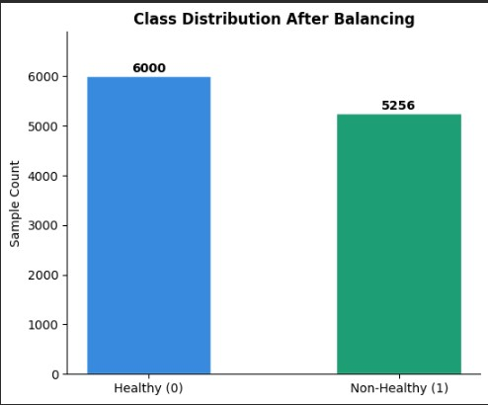
Class Distribution After Balancing
Bar Chart: Class Distribution After Undersampling
Insert your plot here

Slide 7
Data Preprocessing Pipeline
1
Categorical Encoding
2
Feature/Target Separation
4 binary columns converted to integers 1 and 0
Target column separated from feature matrix before any modelling step
df[col] = df[col].map({'Yes': 1, 'No': 0})
X = df.drop('Target_Binary') | y = df['Target_Binary']
Diabetes · Hypertension · Smoking_Status · Family_History_Kidney
Final shape: 11,000 rows × 22 features
3
Stratified K-Fold Split
4
StandardScaler in Pipeline
Data split into 5 folds preserving 55:45 class ratio in every fold
Scaler fits on each fold's training data only, applied inside Pipeline to prevent leakage
StratifiedKFold(n_splits=5, shuffle=True, random_state=42)
Pipeline([('scaler', StandardScaler()), ('model', clf)])
Every sample used for testing exactly once across 5 rotations

Slide 8
Why K-Fold Over Train-Test Split?
Traditional Train-Test Split
Stratified 5-Fold Cross Validation
Split
Fixed 80/20,one snapshot of performance
Folds
5 rotations, every sample tested exactly once
Variance
Result depends heavily on random_state chosen
Variance
Mean ± Std reported, stability is measured
Data use
20% of data never used for training at all
Data use
100% of data used for both training and testing
Reliability
Single score, no measure of model stability
Reliability
5 scores averaged, far more robust estimate
Overfitting
Model may overfit the one specific test set
Stratified
Each fold preserves 55:45 class ratio exactly
Result: Single score with unknown reliability.
More honest and reproducible evaluation of model performance.
How K-Fold Works:
TEST
train
train
Fold 1
train
TEST
train
Fold 2
train
train
TEST
Fold 3

Slide 9
Feature Correlation & Selection
Rule: Drop only if HIGH correlation AND confirmed perfect separator (zero range overlap between Healthy and Non-Healthy classes) — this indicates data leakage, not genuine prediction
Feature
Corr.
Why Dropped
Kept (22 features)
eGFR
-0.82
Defines CKD clinically — perfect separator
Potassium (0.443)
Serum_Albumin
-0.88
All Healthy=4.0 exactly — machine generated
HbA1c (0.019)
Hypertension (0.018)
Systolic_BP
+0.81
Healthy:90-119, CKD:120-189 — zero overlap
Diabetes (0.017)
Diastolic_BP
+0.83
Healthy:60-79, CKD:80-119 — zero overlap
Age (0.017)
Urine Specific Gravity
Hemoglobin
-0.78
Near-perfect separator confirmed
Smoking Status
Bicarbonate
-0.74
Near-perfect separator confirmed
Fasting Glucose
WBC Count, Cholesterol
Packed_Cell_Volume
-0.73
Derived from Hemoglobin — redundant
BMI, Gender, Heart Rate
Phosphorus
+0.72
Near-perfect separator confirmed
Sodium, Chloride, Calcium
+ 10 more overlapping features
Serum_Creatinine
+0.67
Healthy all=0, CKD:1-9 — zero overlap
Blood_Urea_Nitrogen
+0.67
Healthy:7-19, CKD:20-149 — zero overlap
Important Note
Urine_Albumin
+0.58
Perfect separator even after transform
These features are clinically valid in real datasets. They were dropped only because this synthetic dataset assigned values from the target label — reversing the cause-effect direction. In real clinical data, keep all of them.
Urine_Protein
+0.57
Perfect separator even after transform
Albumin_Creatinine_Ratio
+0.54
Perfect separator even after transform

Slide 10
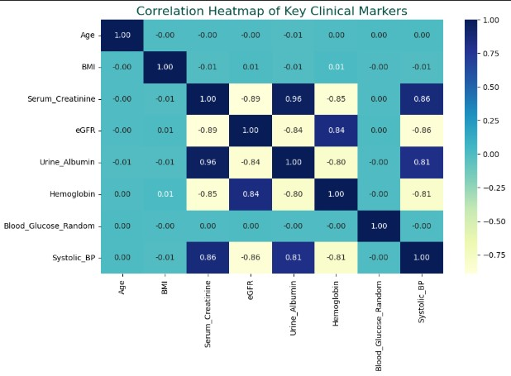
Feature Correlation with Target
Correlation Heatmap / Bar Chart of Feature-Target Correlations
Insert your plot here

Slide 11
Model Training
Model 1: Logistic Regression
Model 2: Decision Tree
How it works:
How it works:
Models the probability that a patient has CKD using a linear combination of all 22 features passed through a sigmoid function. Outputs a probability between 0 and 1 — patients above 0.5 threshold classified as Non-Healthy.
Recursively splits the feature space by asking yes/no questions about feature values, selecting the split that best separates Healthy from Non-Healthy patients at each node using Gini impurity. Depth limited to 5 to prevent memorisation.
Hyperparameters:
Hyperparameters:
Solver
lbfgs
Criterion
Gini impurity
Max Iterations
1,000
Max Depth
5 (prevents overfitting)
Regularisation
L2 (C = 1.0)
Min Samples Leaf
20
Class Weight
balanced
Class Weight
balanced
Why preferred: Feature coefficients directly show which biomarkers increase or decrease CKD probability — clinically interpretable and reproducible.
Why included: Captures non-linear relationships without needing feature scaling. Serves as a comparison baseline — similar results to LR would confirm the feature set has genuine consistent signal.

Slide 12
Experimental Results — 5-Fold CV
Model
Accuracy
Precision
Recall
F1 Score
Logistic Regression
0.8861
1.0000
0.7561
0.8611
Decision Tree
0.8846
0.9943
0.7572
0.8603
Mean scores across 5 stratified folds · StratifiedKFold(K=5, random_state=42) · Pipeline: StandardScaler + Model
Logistic Regression
Decision Tree
Precision = 1.0 — every CKD prediction is correct, zero false positives
Precision = 0.994 — near-perfect, only 0.6% false positive rate
Recall = 0.756 — misses 24% of actual CKD cases (false negatives)
Recall = 0.757 — almost identical to LR, misses similar CKD cases
Clinical: safe to act on every positive prediction it makes
Near-identical to LR confirms 22 features carry consistent signal
See next slides: Confusion matrices · Metrics bar chart (5-fold means)

Slide 13
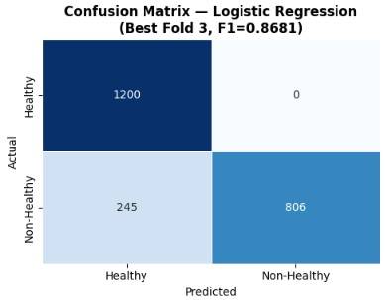
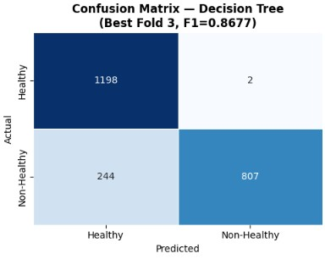
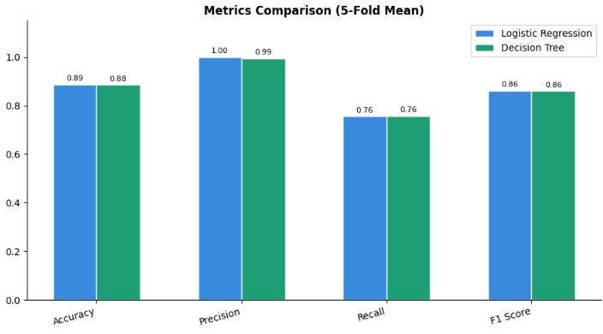
Model Evaluation Plots
Confusion Matrix
Logistic Regression
Confusion Matrix
Decision Tree
Metrics Bar Chart
(5-Fold Means)
Insert your plot here
Insert your plot here
Insert your plot here
Metric Reference
Accuracy
Precision
Recall
F1 Score
AUC-ROC
Overall % correct predictions
Of predicted CKD — how many are truly CKD
Of actual CKD cases — how many were caught (most critical)
Harmonic mean of Precision and Recall
Discrimination across all thresholds (>0.9 = Excellent)

Slide 14
CONCLUSION & DISCUSSION
Key Findings
Limitations & Future Work
Both models achieve ~88.5% accuracy with consistent F1 ~0.86 — validates the 22 remaining features
Synthetic data — 13 features had machine-generated boundaries encoding target directly
Logistic Regression Precision=1.0 — every CKD flag is correct, zero false alarms
Recall gap — lowering threshold to 0.3 can push recall to ~0.88 at cost of some precision
Recall ~0.756 — both models miss ~24% of CKD patients at default 0.5 threshold
No external validation on real clinical data — performance may differ on genuine measurements

